Slide 1

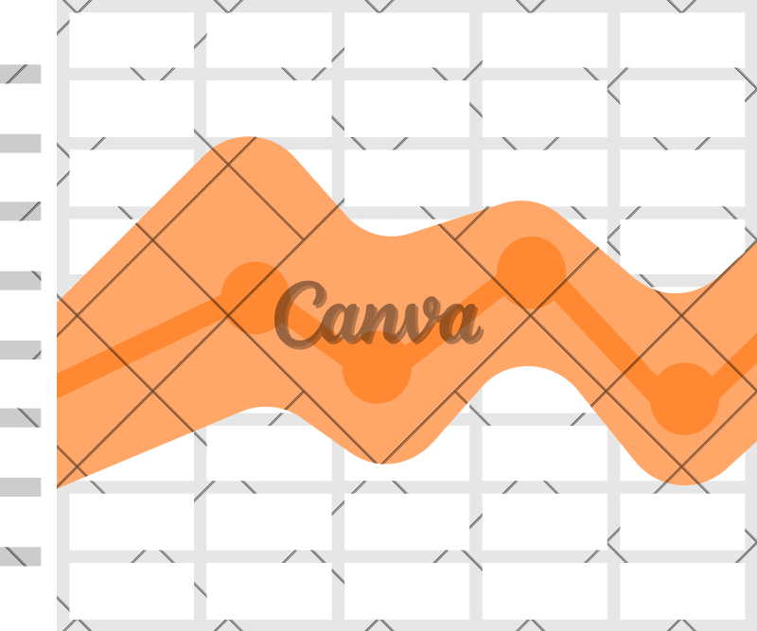
Time Series Analysis on Store Item Demand Forecasting

Slide 2


TEAM WORKING ON THIS
Venkata Thejaswi Mullapudi
Nandith Malyadheesh Kurra
Vikas Kumar Vejendla
Susendranath Reddy Musani

Slide 3

PROBLEM STATEMENT :
Conduct time series analysis to explore historical data patterns, anomalies, and trends in a specific domain or industry. The objective is to derive actionable insights for informed decision-making without forecasting future values, ultimately improving strategies and operations based on data-driven findings.

Slide 4



01.
ANOMALY DETECTION
Identify unusual patterns or outliers in time series data.
02.
03.
TREND ANALYSIS
Inaccurate results in long term.
SMOOTHING AND FILTERING
Reduce noise in a time series data to reveal underlying patterns.
PROBLEM BREAKDOWN

Slide 5



THE SOLUTION
ANOMALY DETECTION
TREND ANALYSIS
SMOOTHING AND FILTERING
Statistical methods like Z- score, machine learning models (e.g., Isolation Forest), or deep learning techniques (e.g., autoencoders) can be used for anomaly detection.
Techniques like linear regression, polynomial regression, or exponential smoothing can be used to model and analyze trends
Moving averages, Exponential Moving Averages (EMA), or Kalman filtering can be used for smoothing and noise reduction.

Slide 6

DATA :
For this project, the dataset is sourced from https://www.kaggle.com/code/lasm1984/storesales-eda-and- prophet-multi-models/input
This time series dataset contains records from the year 1-1- 2013 to 12-31-2017.

Slide 7










Business Understanding
BUSINESS MODEL
Deployment
Data Understanding
DATA
Evaluation
Data Preparation
Modelling

Slide 8

01. BUSINESS UNDERSTADING:
From the business perspective, if we are aware of what circumstances the sales fluctuate, we can predict the future sales and demand.
In our scenario, the business question could be “What could be the number sales of the store by considering a particular date, store id, item id.”

Slide 9

02. DATA UNDERSTANDING:
The following fields can be found in the data :
Date - The week of sales.
Store ID - Unique ID of a particular store. Item ID - Unique ID of a particular item.
Sales - Total no of sales.

Slide 10

03. DATA PREPARTION:
We have checked and removed NULL data.
Conversion of the ‘Date’ of data type object to datetime for segregating data to Quarter, Year, Month and Day.
Conversion of months and days from numerics to categories.
Classification of data into different seasons. Moving mean and ADCF Test.
ACF/PACF charts.

Slide 11

04. MODELLING:
We have used ARIMA and SARIMA modelling techniques.
Prediction using SARIMA modelling resulted in more accuracy.

Slide 12

05. EVALUTION:
For the evaluation purpose we have used linear regression model.
We have defined data into training sets. Got accuracy of 90.67%

Slide 13


06. DEPLOYMENT:
Deployed the model in the web using Gradio.
The model can be accessed via http://127.0.0.1:7860 or https://6f3139f20cb107cdd7.gradio.live/
Taken inputs as start date, end date, item, store from users to predict the sales.

Slide 14
DEMO

Slide 15

THANK YOU

